Slide 1
DEPARTMENT OF CSE/ CSIT/ AI&DS
COURSE NAME – cloud devops(epam)
COURSE CODE – 22CS2243F
INTEGRATING JENKINS WITH GITHUB

Slide 2
AIM OF THE SESSION
To familiarize students with the basic concept of Specialized Process Models
INSTRUCTIONAL OBJECTIVES
This Session is designed to:
Demonstrate Specialized Process Model
Describe The Unified Process
3. List out the Component Based Development
4. Describe Formal Methods Model
5. Describe Aspect-Oriented Software Development
LEARNING OUTCOMES
At the end of this session, you should be able to:
Describe various specialized process models
Summarize phases of unified process

Slide 3
What is Git?
Git is a Version Control System (VCS) designed to make it easier to have multiple versions of a code base, sometimes across multiple developers or teams.
It allows you to see changes you make to your code and easily revert them

Slide 4
Hosting repositories on Github facilitates the sharing of codebases among teams by providing a GUI to easily fork or clone repos to a local machine.
By pushing your repositories to Github, you will pretty much automatically create your own developer portfolio as well

Slide 5
Configuring git
$ git config --global user.name
> should be your name, i.e. Jon Rosado
$ git config --global user.email
> should be your email, i.e. jon.rosado42@gmail.com

Slide 6
To fix either, just add the desired value in quotes after the command:
$ git config --global user.name “Jon Rosado”
$ git config --global user.email “jon.rodado42@gmail.com"

Slide 7
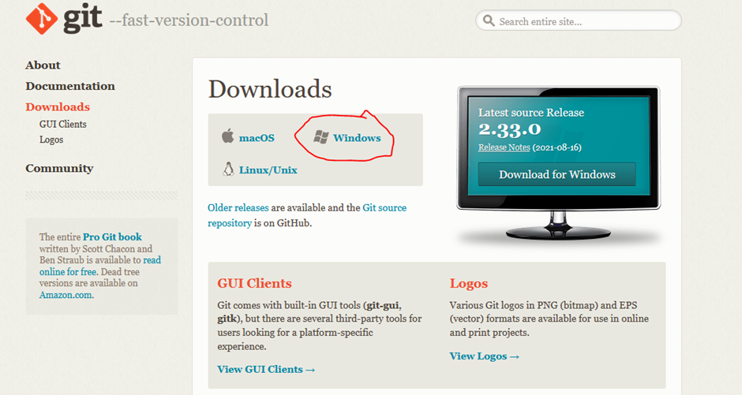
Deploy Files to Github via GIT
Install gitbash software
https://git-scm.com/downloads

Slide 8
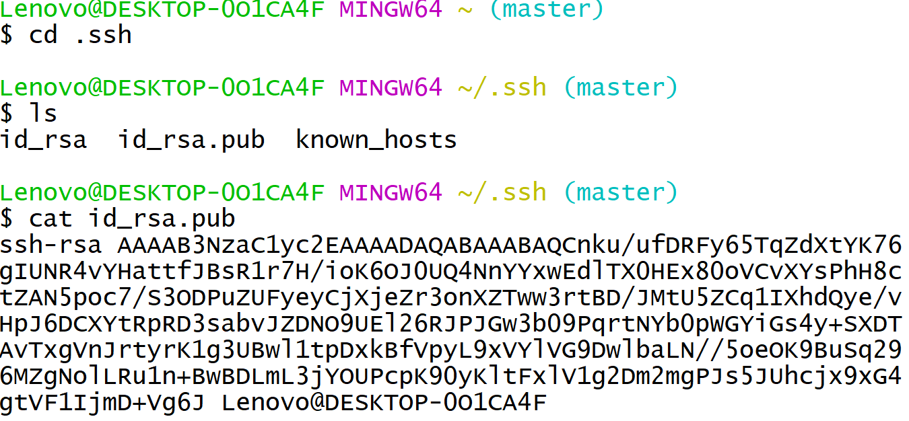
To check the public key is configured or not
Key creation

Slide 9

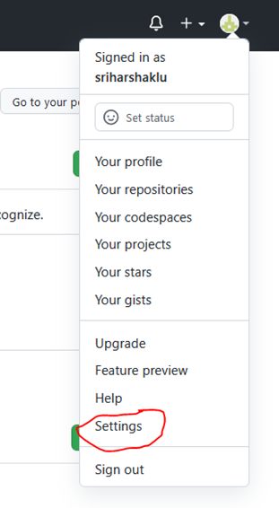

Slide 10
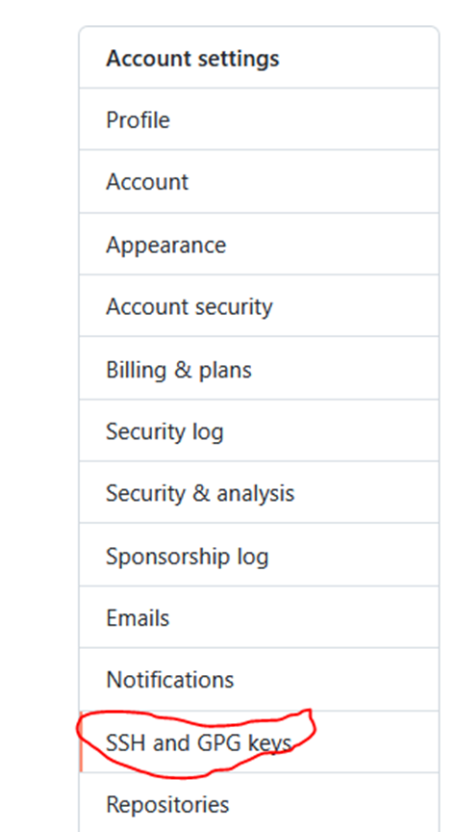
Click on settings

Slide 11
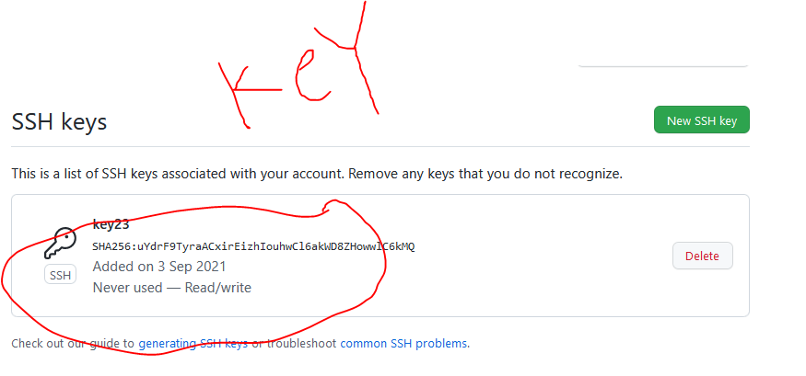

Slide 12
Step : if key not there follow steps
Follow the steps to generate RSA Key
Public key generation
So we need to generate key
Steps to generate key

Slide 13
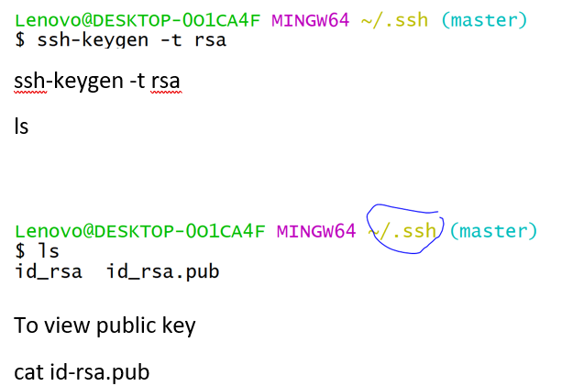
Cd .ssh

Slide 14
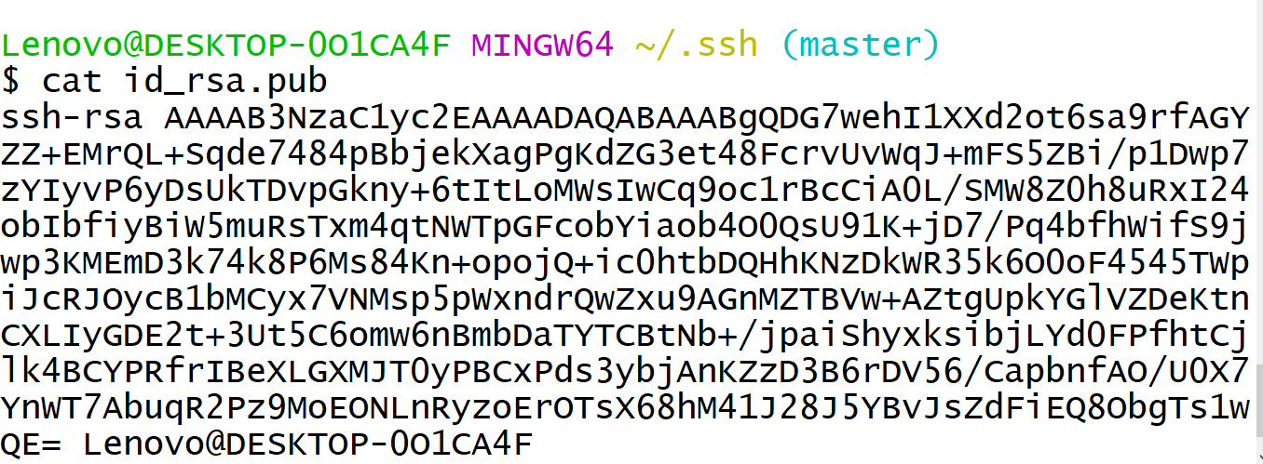
Copy code with no blank spaces

Slide 15
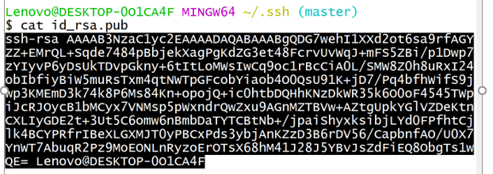

Slide 16
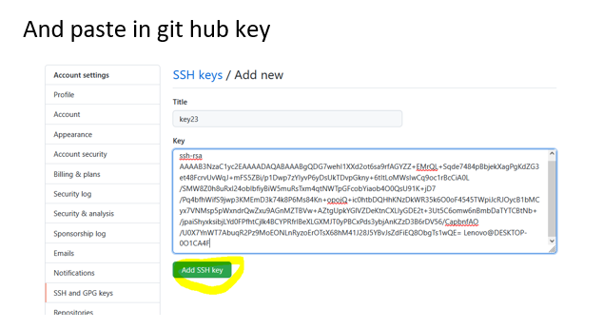

Slide 17
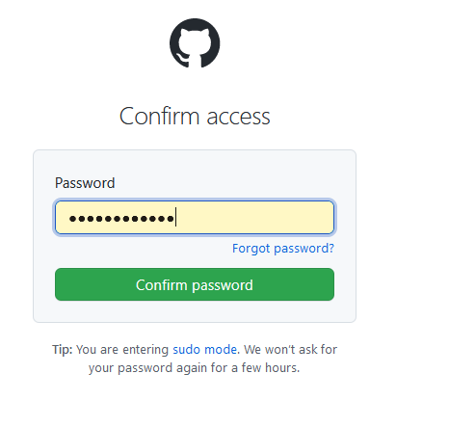

Slide 18
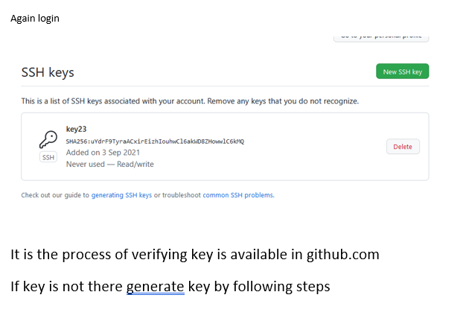

Slide 19
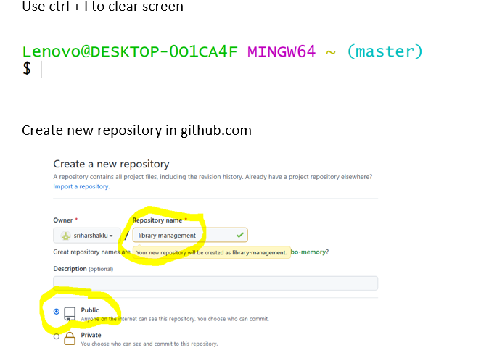

Slide 20
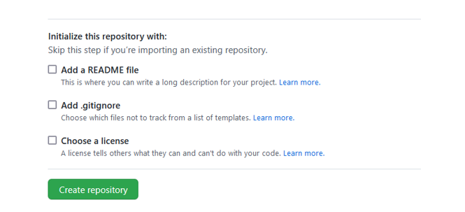

Slide 21
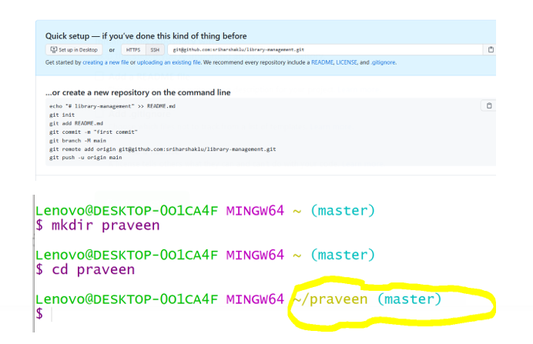

Slide 22
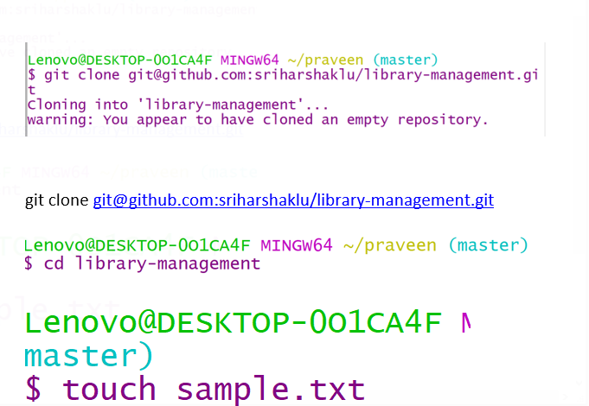

Slide 23
To create files
Use touch file name.extension
To add content in the file
Use command
Vi filename.extension

Slide 24
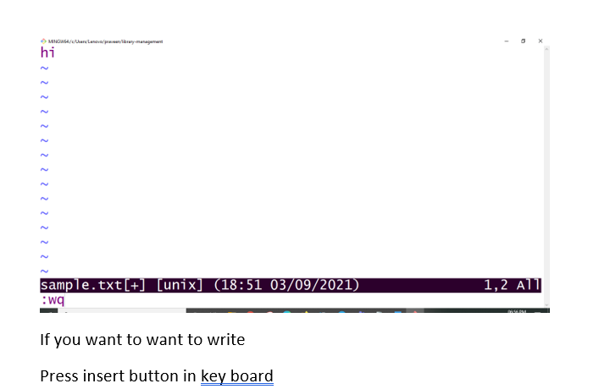

Slide 25
If you want to want to write
Press insert button in key board
After writing the code
If you want to close vi prompt
Press esc button
Then type
:wq
Press enter
To come to main prompt i.e $

Slide 26
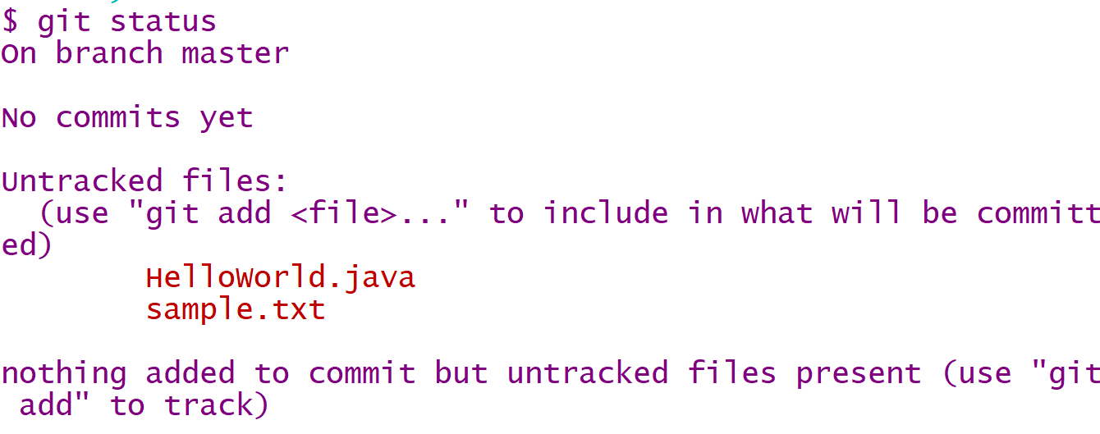

Slide 27
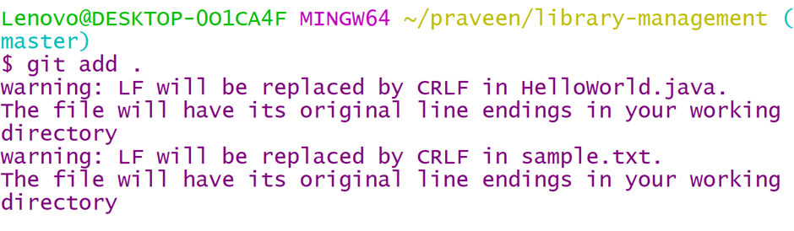
The apply command
git add .

Slide 28
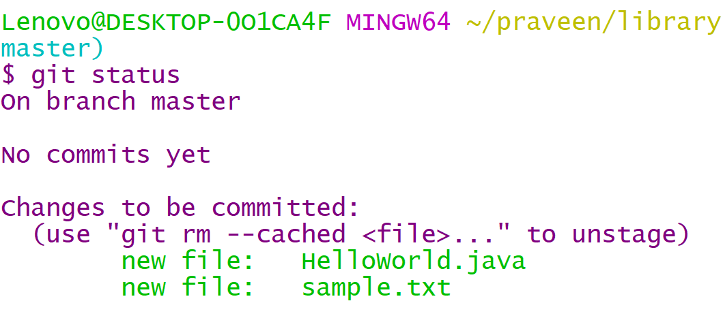

Slide 29
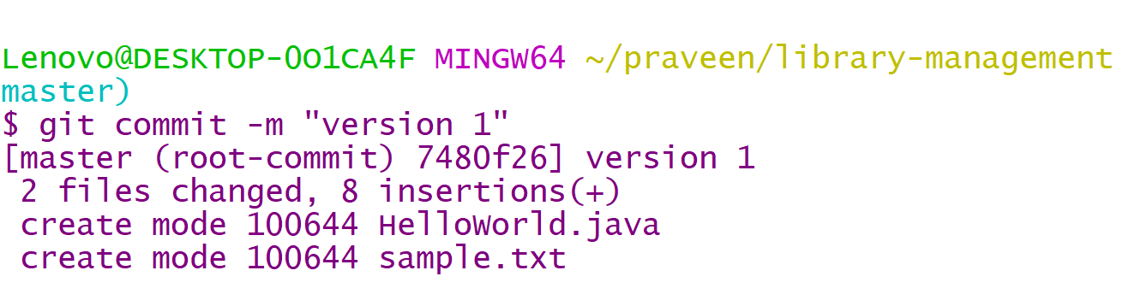
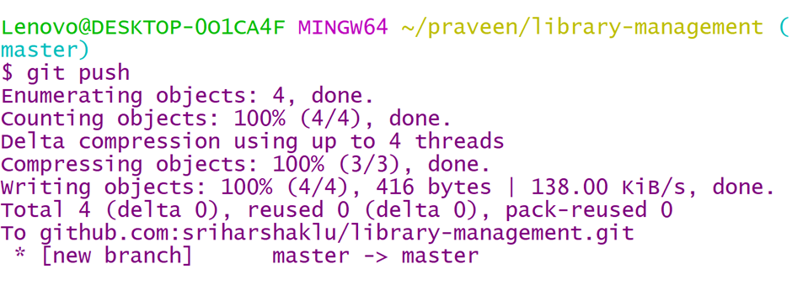
files are green color indicates that added to github repository

Slide 30
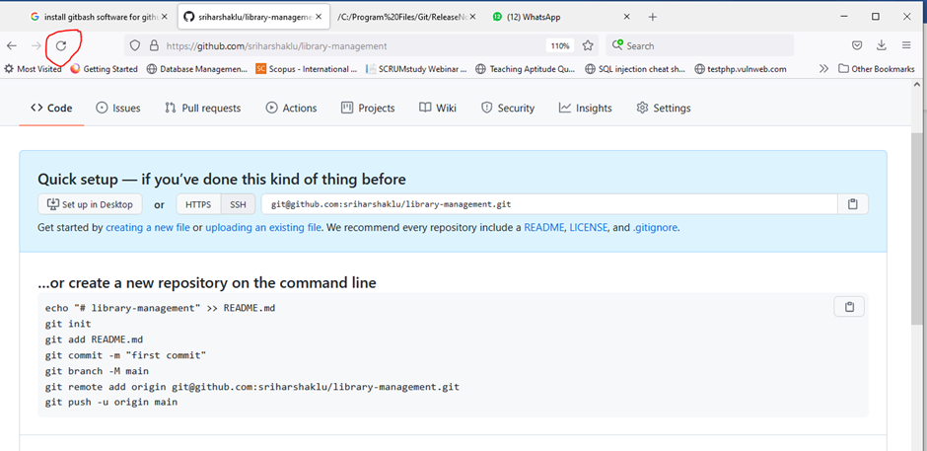
Refresh the github repository page

Slide 31
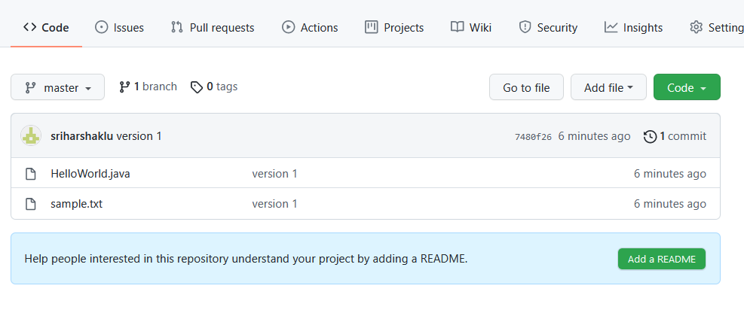

Slide 32
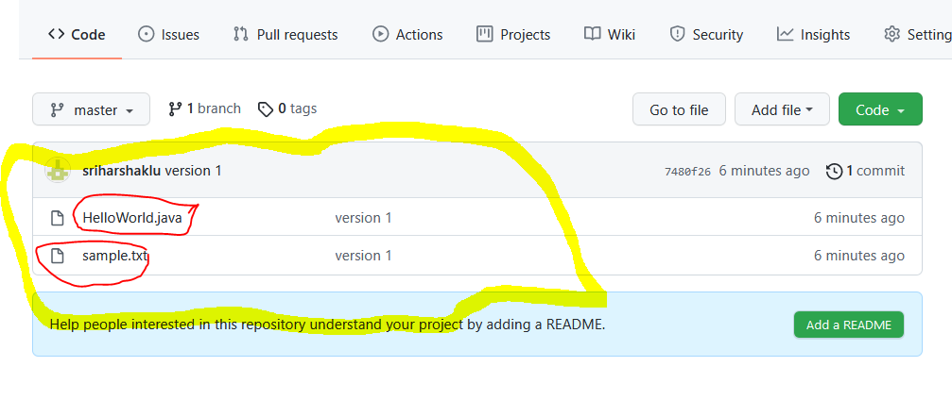

Slide 33
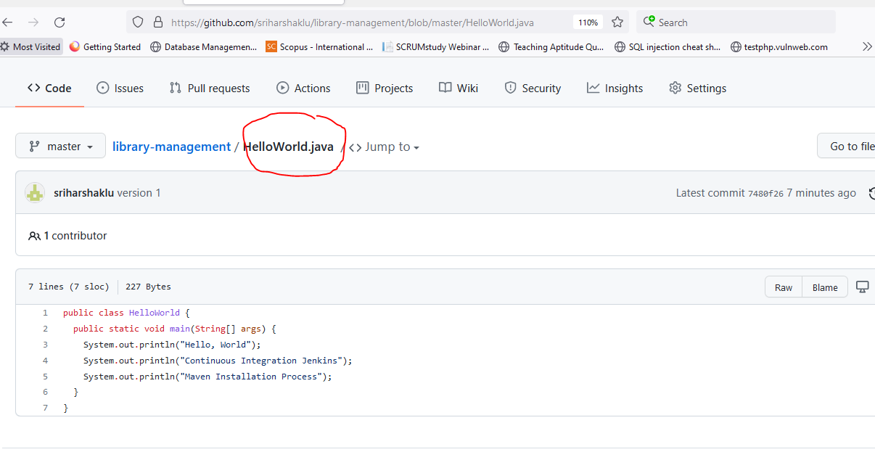
Click on HelloWorld.java

Slide 34
Then create pipeline in azure to build java program

Slide 35
Connecting git with Github
In order to prevent having to enter your password each time you push up to Github, you must configure git and Github to recognize Secured Shell (SSH) keys that you generate.
To check and see if you have any recognized SSH keys active on Github, go to https://github.com/settings/keys
If you do not see any SSH keys listed, you do not have SSH configured with Github. We can assist with this later.
If using Mac OS X, you can also configure your keychain to automatically enter your password via HTTPS.

Slide 36
Connecting git with Github
From your project directory, run `git init` to initialize a git repository.
Go to Github and create a new repository with the name of your project.
Follow the instructions on Github to connect your initialized git repository to the remote server on Github.
Please Note: you must have files in your project directory to commit in order to push anything to your remote server.

Slide 37

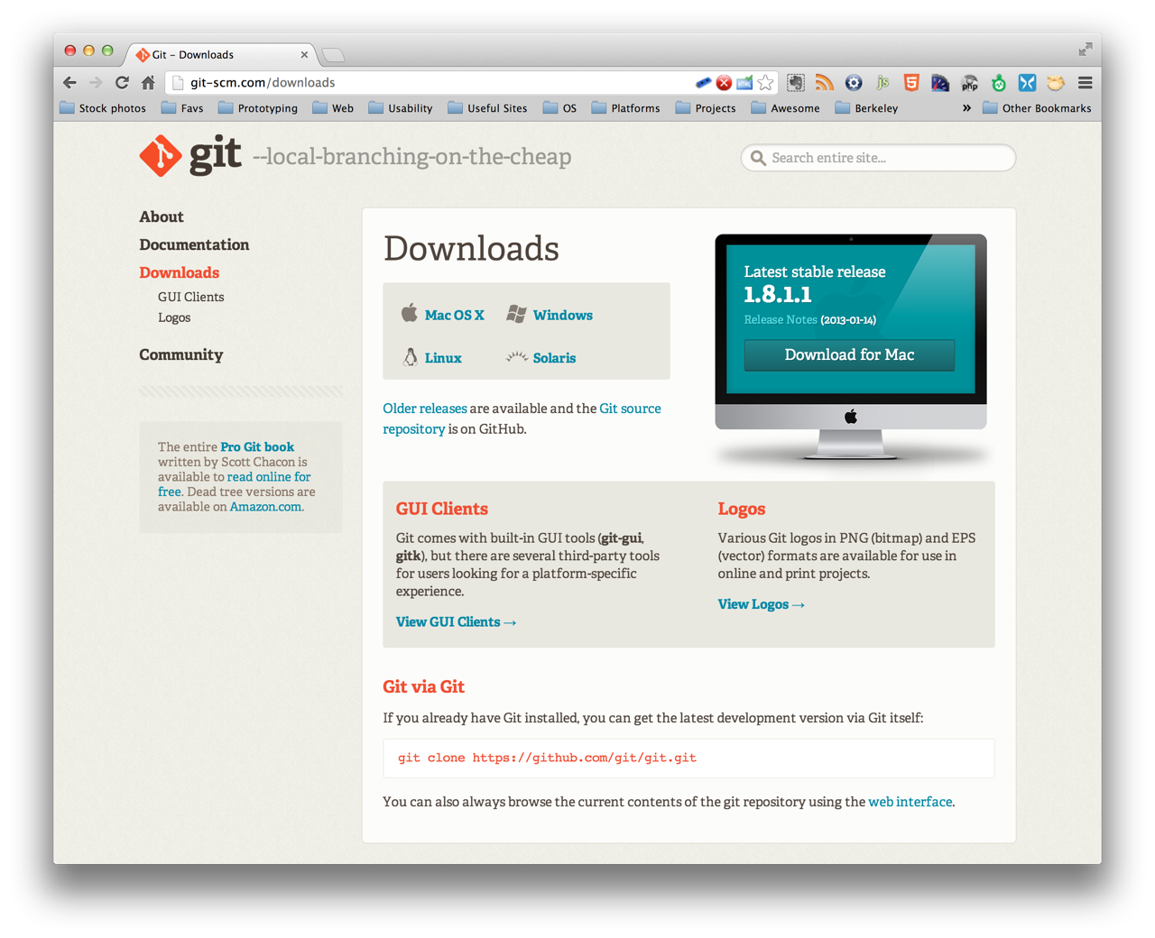
installing git
http://git-scm.com/downloads
Notes:
We’ll be using the git command line interface, but feel free to choose your preferred solution GUIs, Editor Extension etc

Slide 38
Basic git / Github workflow
From your project repo on Github, navigate to the Issues tab and create a new Issue
From the command line, use git to create a new branch off of master to make your edits to. To tie the branch to your issue on Github, make sure to include the issue number after the branch name, e.g. branchName #1
Stage edits to be committed to your git repository by using `git add ` to track the files that you want to add directly or `git add .` to add all files at the current directory level that you have worked on.
Commit changes using `git commit -m ` and be sure to leave a short but descriptive message detailing what the commit will change when merged to the master branch.
Push changes to save them by using `git push origin

Slide 39
Basic git / Github workflow
On Github, create a new pull request for the branch that you have just pushed, and add any clarifying comments that you deem necessary.
In order to close the issue associated with the pull request, tell GitHub to do so by adding ‘closes ’ in the comments. (you can also use ‘closed, fix, fixes, resolve, resolves, and resolved’ before the issue number as well).
Github will automatically check for merge conflicts. If there are any, check to see what they are and resolve them.
• Once everything is up to date, Github will allow you to merge using three separate options: Merge; Squash and Merge; Rebase and Merge

Slide 40
git branching
git branch to view current branches in repo
git checkout -b to create a new branch with branch name
git checkout without ‘-b’ flag to switch to existing branches

Slide 41
Merging vs Rebasing
From a conceptual standpoint, git merge and git rebase are used to achieve the same ultimate goal: to integrate changes from one branch into another branch.
There are, however, distinct mechanics to both methods.

Slide 42
git merge: pros
Generally the easiest option to merge your master branch into your current working feature branch.
You can `git checkout feature` and then `git merge master` or you could just do it with one command: git merge feature master
By doing this, you create a new ‘merge commit’ in your feature branch, which is a non-destructive operation that ties the histories of both branches.
This preserves the exact history of your project

Slide 43
git merge: cons
The branch that you merge will always have an extraneous merge commit that will be tracked every time you need to incorporate upstream states.
• In other words, it essentially creates a forked history at the point where you merge.
• This can lead to muddling the history of your branch, thereby making it more difficult for yourself or other developers to track the history of changes using `git log` and/or roll back to previous states.

Slide 44
git rebase: pros
To rebase, you would `git checkout feature` and then `git rebase master`.

Slide 45
git rebase: pros
To rebase, you would `git checkout feature` and then `git rebase master`.
• Instead of creating a merge commit, rebase will move the entire feature branch to start from the tip of the master branch by rewriting the project history and creating brand new commits for each commit in the original branch.

Slide 46
git rebase: cons
Because rebase rewrites project history, you lose the context provided by a merge commit, i.e. you won’t be able to see when upstream changes were actually integrated into the feature branch.
More importantly, you could potentially cause extreme difficulty by rebasing master to the tip of your feature branch, leading git to think that your master branch’s history has diverged from the rest

Slide 47
Merge conflicts
Merge conflicts arise when two members of the same development team work on the same file and try to merge in their respective changes.
The proper way to avoid merge conflicts would be to ensure that only one branch is fully committed, pushed, and merged to master, allowing the other branch to integrate any changes before attempting to push and merge to master.
If merge conflicts arise, don’t fret! Many text editors (as well as Github) provide tools to help track down conflicts and resolve them. Often times, it will show incoming changes juxtaposed with the current state of your file, and allow you to choose which to keep (one or both)

Slide 48
SELF-ASSESSMENT QUESTIONS
Describe about work flow of github.
2. List the Various commands in github.
Difference between branching and merging in github
Importance of installing and deploying a file in github via gitbash.
Infer about pros and cons on git rebase in project management.

Slide 49
REFERENCES FOR FURTHER LEARNING OF THE SESSION
TEXTBOOKS:
1. Roger S.Pressman, “Software Engineering – A Practitioner’s Approach” 7th Edition, Mc Graw Hill,(2014).
2. Ian Sommerville, “Software Engineering”, Tenth Edition, Pearson Education, (2015).
3. Agile Software Development Ecosystems, Jim Highsmith, Addison Wesley; ISBN: 0201760436; 1st edition
Reference Book
Agile Modelling: Effective Practices for Extreme Programming and the Unified Process Scott Amber John Wiley & Sons; ISBN: 0471202827; 1st edition.
WEB REFERNCES/MOOCS:
https://www.digite.com/kanban/what-is-kanban/
http://www.scaledagileframework.com
https://www.guru99.com/test-driven-development.html
https://junit.org/junit5/

Slide 50

THANK YOU
Team – ADAPTIVE SOFTWARE ENGINEERING

